Slide 1
Chemistry – Jan 23, 2020
P3 Challenge-
  How many electrons can the n=3 shell hold?
Objective –
  Periodic Trends Revisit
  Review
Hand in Atomic Game WS

Slide 2
Chemistry – Jan 23, 2020
Objective –
  Periodic Trends
Agenda
  Omelet Review
  Time for Review WS
Assignment: Study for test

Slide 3
Ions
In neutral atoms, # protons = # electrons
Identity of an atom is solely dependent on # protons, Z
# electrons can and often do vary some due to chemical reactivity, though usually not more than by +/- 3
If #electrons ≠ #protons, then an ion is formed.
Anions have a negative charge and have extra electrons
  Ex: F + e⁻ → F⁻ O + 2 e⁻ → O⁻²
Cations have a positive charge and are missing electrons
  Ex: Na → Na⁺ + e⁻ Ca → Ca⁺² + 2 e⁻

Slide 4
Ions and the periodic table
Group of Elements | Type of ion formed
Alkali Metals & Hydrogen | +
Alkaline Earth Metals | +2
Group 13 | +3
Group 15, nonmet. | –3
Group 16, nonmet. | –2
Halogens | –
Group of Elements | Type of ion formed
Noble Gases | None
Transition Metals | Multiple positive ions
Lanthanides and Actinides | Uncommon, varies
Other elements with only one possible charge: Ag⁺, Zn²⁺, Cd²⁺, Al³⁺, Ga³⁺ (memorize)

Slide 5
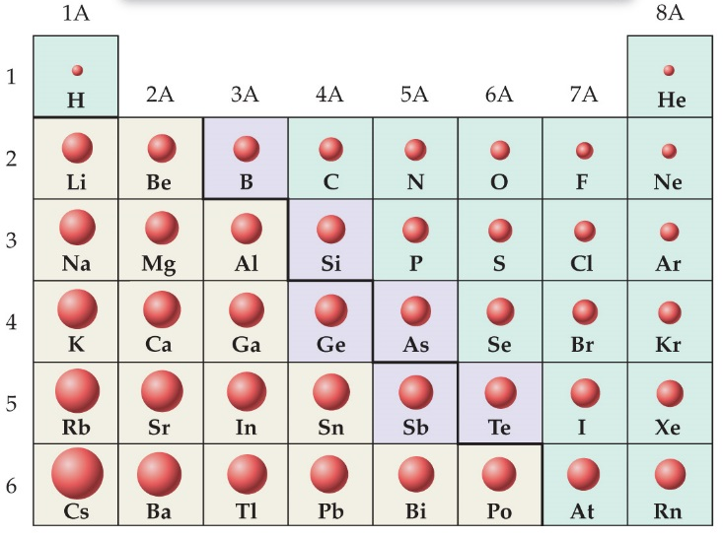
Periodic Trends – Atomic Size (2 trends)
1) Atoms with a larger period number (n) are larger.
  (going down a group: as n  size )
2) The size of atoms in the same period, as the relative positive charge increases due to Z increasing, the size of the atoms decreases.
  (going across a period L to R, if n =: as Z  size)
Largest atom is Fr/Cs
  Memorize this fact to easily recreate the periodic table trends for atomic size
Be able say which of a pair of elements is larger/smaller.

Slide 6
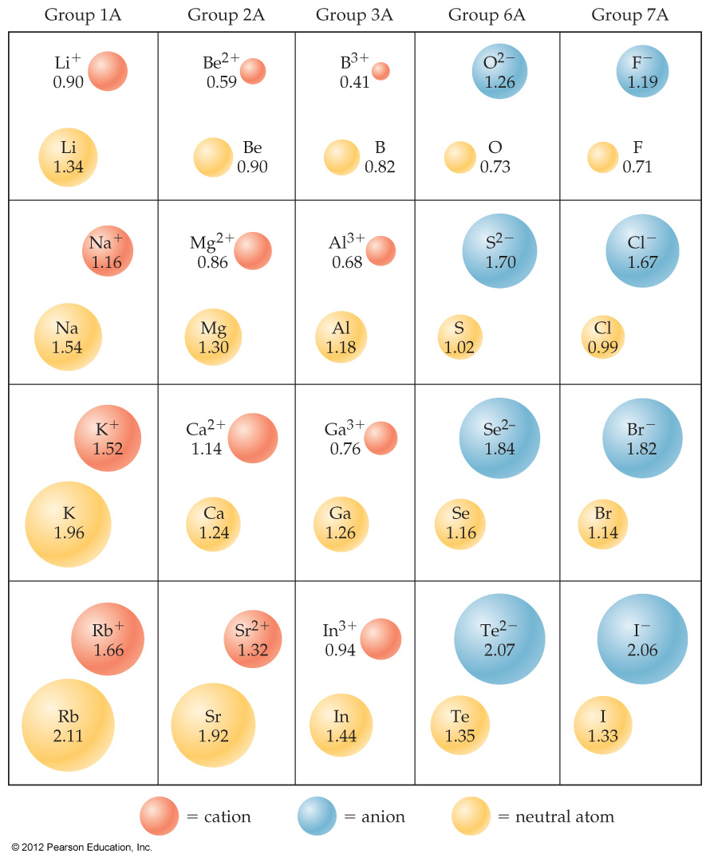
Sizes of Ions
Cations are smaller than their neutral atoms.
Anions are larger than their neutral atoms.
Ion size increases going down a group because of increasing n.
Ion size decreases from L to R because of increasing nuclear charge.
  Consider cations/anions separately.

Slide 7
Sizes of Ions
In an isoelectronic series, ions have the same number of electrons. O²⁻, F⁻, Na⁺, Mg²⁺, Al³⁺
  They have the same electron configuration with different number of protons in the nucleus
Ionic size decreases with an increasing nuclear charge.

Slide 8
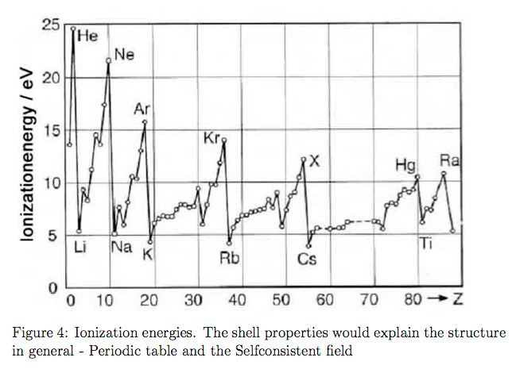
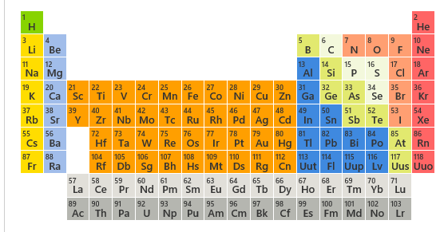
Periodic Trends – Ionization Energy
Ionization energy is the energy needed to remove a single electron
  1) Atoms that want to lose an electron (alkali) will have a low ionization energy. It’s easy to remove an electron from them.
    In general, going across a period L to R, as Z  Ion E 
2) Atoms with a larger period number have lower ionization energies because it’s easier to remove an electron that far away from the nucleus.
  going down a group: as n  ion E 
Highest ionization energy is He
Notes:
Chapter 9, Figure 9.34

Slide 9
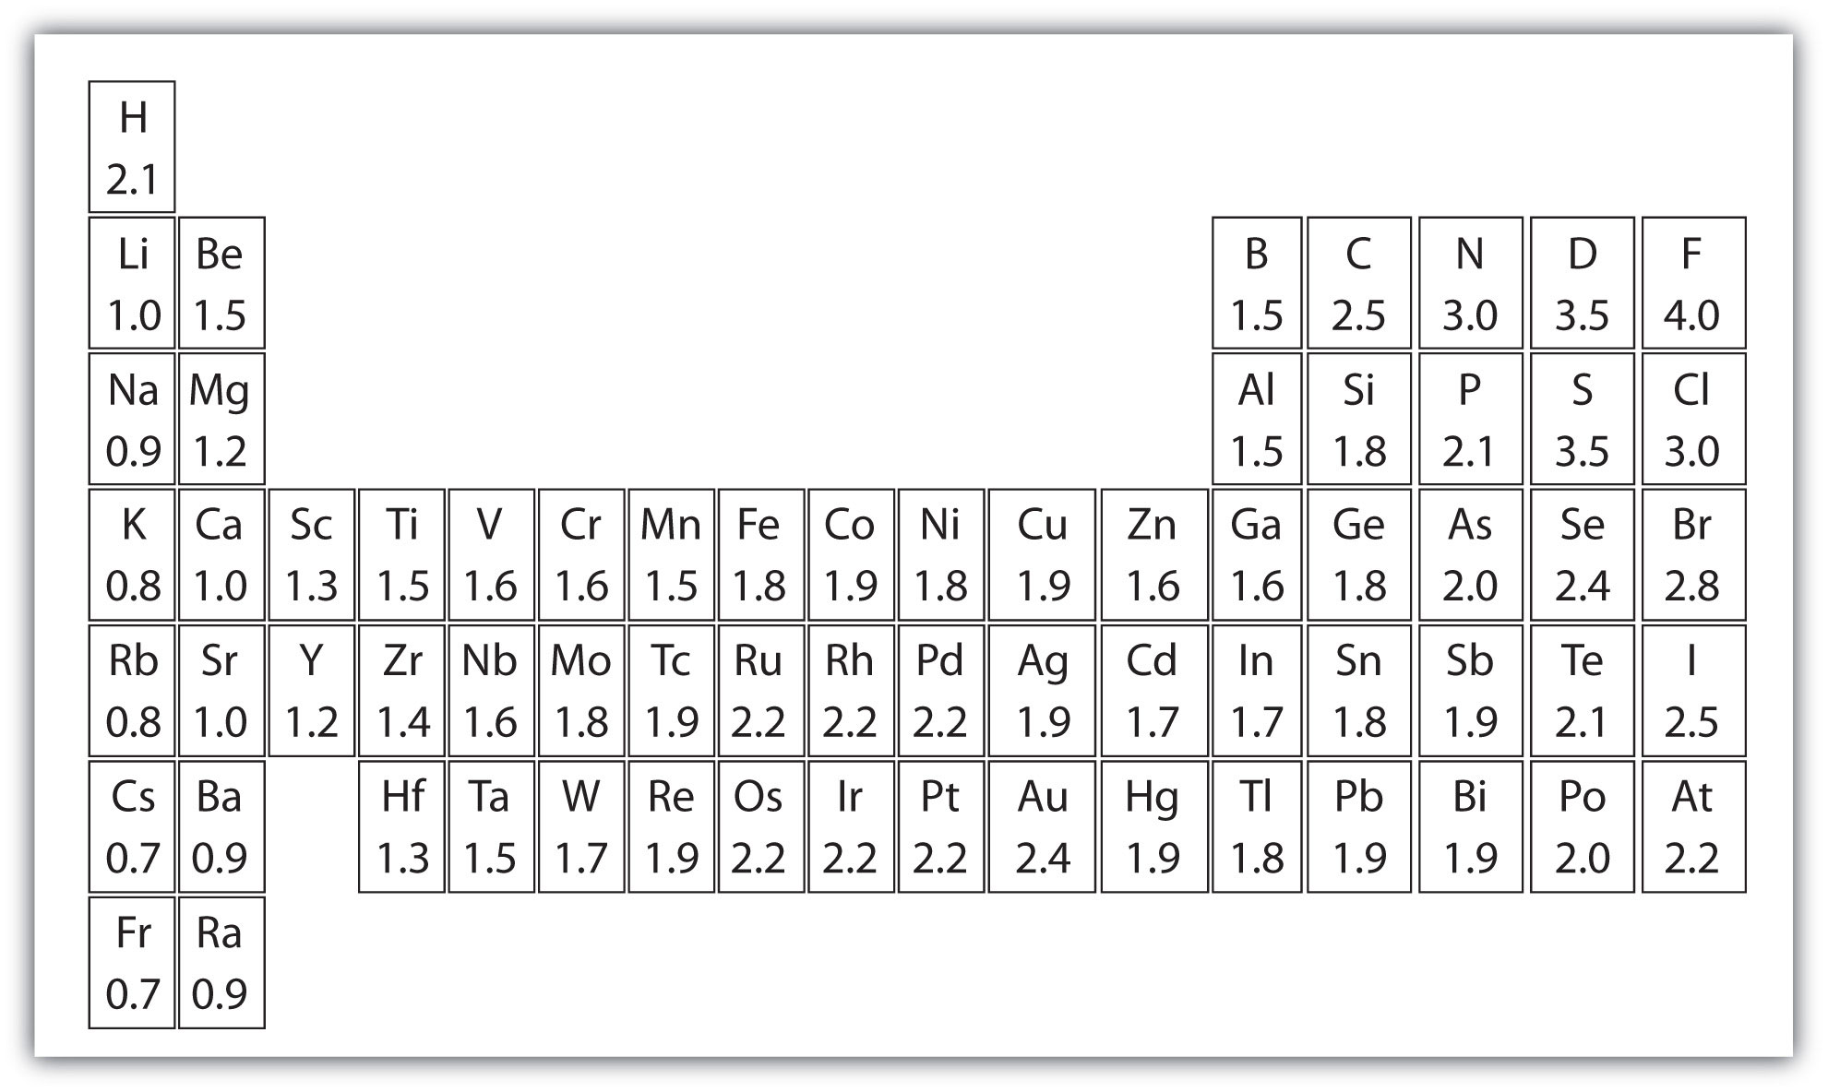
Electronegativity
Electronegativity is the ability of atoms in a molecule to attract electrons to themselves.
On the periodic chart, electronegativity increases as you go…
  …from left to right
  …from the bottom to the top
Note the most electronegative element F.
Undefined for Noble Gases

Slide 10
Exit Slip - Homework
Exit Slip:
  A) Which has a higher ionization energy, Aluminum or Chlorine? B) Why? (answer should use the terms nuclear charge and subshell)
What’s Due? (Pending assignments to complete.)
  Review WS and Study for Test on 1/28
What’s Next? (How to prepare for the next day)
  Read Holt p84 - 88

